Slide 1



ecx.io Frontend Bootcamp — Javascript Day 02 24.06.2021.

Slide 2

Agenda
Conditions
Loops
Functions

Slide 3


Conditions

Slide 4
Conditions
Is the numeric value of variable `A` greater than the numeric value of variable `B`?
Is the length of string `A` equal to the length of string `B`?
Is the date greater than yesterday's date or any given date?
Did something happen in previous code execution?
Did we iterate the desired amount of times over a code block?

Slide 5
Conditions
Operators
Operator | Description
Equal (==) | Returns true if the operands are equal.
Not equal (!=) | Returns true if the operands are not equal.
Strict equal (===) | Returns true if the operands are equal and of the same type.
Strict not equal (!==) | Returns true if the operands are of the same type but not equal, or are of different type.
Greater than (>) | Returns true if the left operand is greater than the right operand.
Greater than or equal (>=) | Returns true if the left operand is greater than or equal to the right operand.
Less than (<) | Returns true if the left operand is less than the right operand.
Less than or equal (<=) | Returns true if the left operand is less than or equal to the right operand.

Slide 6
Conditions
Operators

Slide 7
Truthy & Falsy
In JavaScript, a truthy value is a value that is considered true when encountered in a Boolean context.
All values are truthy unless they are defined as falsy (i.e., except for false, 0, -0, 0n, "", null, undefined, and NaN)
Notes:
https://developer.mozilla.org/en-US/docs/Glossary/Truthy
https://developer.mozilla.org/en-US/docs/Glossary/Falsy

Slide 8


if statement

Slide 9
if statement
The if statement executes a statement if a specified condition is truthy. If the condition is falsy, another statement can be executed.

Slide 10
if statement
The if statement executes a statement if a specified condition is truthy. If the condition is falsy, another statement can be executed.
Multiple if...else statements can be nested to create an else if clause. Note that there is no elseif (in one word) keyword in JavaScript.

Slide 11
if statement
Real live examples

Slide 12
if statement
Real live examples

Slide 13
if statement
Real live examples

Slide 14
Logical Operators
If you want to test multiple conditions without writing nested if...else statements, logical operators can help you. When used in conditions, the first two do the following:
&& — AND; allows you to chain together two or more expressions so that all of them have to individually evaluate to true for the whole expression to return true.
|| — OR; allows you to chain together two or more expressions so that one or more of them have to individually evaluate to true for the whole expression to return true.

Slide 15
Logical Operators
AND

Slide 16
Logical Operators
OR

Slide 17
Logical Operators
NOT OR (NOR)

Slide 18
Operator precedence
Operator precedence determines how operators are parsed concerning each other. Operators with higher precedence become the operands of operators with lower precedence.
Notes:
https://developer.mozilla.org/en-US/docs/Web/JavaScript/Reference/Operators/Operator_Precedence#table

Slide 19
switch statement
A switch statement is similar to IF and is of use when you need to execute one code out of the multiple code block execution possibilities, based on the result of the expression passed.
Switch statements carry an expression, which is compared with values of the following cases and once a match is found, code associated with that case executes.

Slide 20
switch statement
Real live examples

Slide 21
Exercise
Using a switch statement, check the name of the keyboard layout and return following:
QUERTY -> 0
QWERTZ -> 1
All other cases -> null

Slide 22
Loops

Slide 23
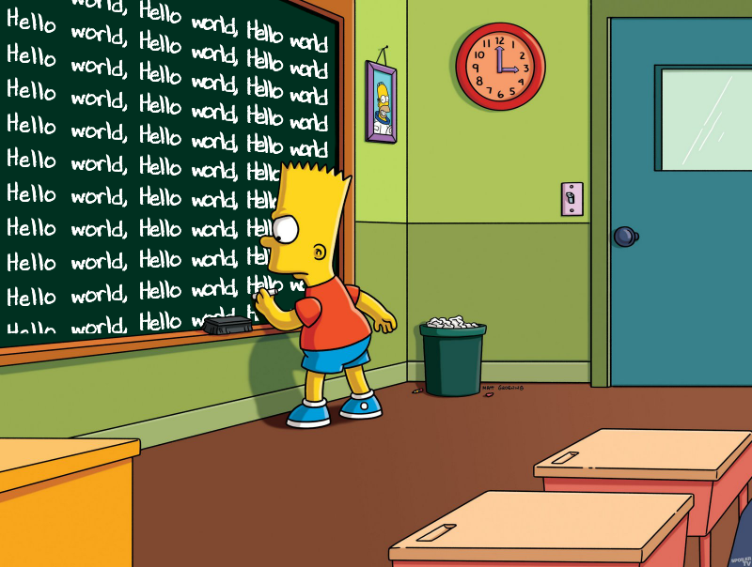
Loops
Looping, for any programming language, is a powerful tool in order to execute a set of instructions, repeatedly, while the expression passed is satisfied. A very basic example can be, to print “Hello World” for 10 times.
There are many different kinds of loops, but they all essentially do the same thing: they repeat an action some number of times. (Note that it's possible that number could be zero!)

Slide 24
for loop

Slide 25
for loop
A for loop repeats until a specified condition evaluates to false. The JavaScript for loop is similar to the Java and C for loop.

Slide 26
for loop
When a for loop executes, the following occurs: 1. The initializing expression initialExpression, if any, is executed. This expression usually initializes one or more loop counters, but the syntax allows an expression of any degree of complexity. This expression can also declare variables. 2. The conditionExpression expression is evaluated. If the value of conditionExpression is true, the loop statements execute. If the value of conditionExpression is false, the for loop terminates. (If the condition expression is omitted entirely, the conditionExpression is assumed to be true.) 3. The statement executes. To execute multiple statements, use a block statement ({ ... }) to group those statements. 4. If present, the update expression incrementExpression is executed. 5. Control returns to Step 2.

Slide 27
for loop

Slide 28
for loop

Slide 29
for loop

Slide 30
for loop

Slide 31
do…while loop

Slide 32
do…while loop
The do...while statement creates a loop that executes a specified statement until the test condition evaluates to false. The condition is evaluated after executing the statement, resulting in the specified statement executing at least once.

Slide 33
while loop

Slide 34
while loop
A while statement executes its statements as long as a specified condition evaluates to true.

Slide 35
break statement

Slide 36
break statement
Use the break statement to terminate a loop, switch, or in conjunction with a labeled statement.
When you use break without a label, it terminates the innermost enclosing while, do-while, for, or switch immediately and transfers control to the following statement.
When you use break with a label, it terminates the specified labeled statement.

Slide 37
continue statement

Slide 38
continue statement
The continue statement can be used to restart a while, do-while, for, or label statement.
When you use continue without a label, it terminates the current iteration of the innermost enclosing loop and continues execution of the loop with the next iteration. In contrast to the break statement, continue does not terminate the execution of the loop entirely. In a while loop, it jumps back to the condition. In a for loop, it jumps to the increment-expression.
When you use continue with a label, it applies to the looping statement identified with that label.

Slide 39
label

Slide 40
label
A label provides a statement with an identifier that lets you refer to it elsewhere in your program. For example, you can use a label to identify a loop, and then use the break or continue statements to indicate whether a program should interrupt the loop or continue its execution.

Slide 41
for…in

Slide 42
for…in
The for...in statement iterates a specified variable over all the enumerable properties of an object. For each distinct property, JavaScript executes the specified statements.

Slide 43
for…in
Arrays
Although it may be tempting to use this as a way to iterate over Array elements, the for...in statement will return the name of your user-defined properties in addition to the numeric indexes. Therefore, it is better to use a traditional for loop with a numeric index when iterating over arrays, because the for...in statement iterates over user-defined properties in addition to the array elements, if you modify the Array object (such as adding custom properties or methods).

Slide 44
for…in

Slide 45
for…of
The for...of statement creates a loop iterating over iterable objects, including: built-in String, Array, array-like objects (e.g., arguments or NodeList), TypedArray, Map, Set, and user-defined iterables. It invokes a custom iteration hook with statements to be executed for the value of each distinct property of the object.

Slide 46
for…of vs for…in
Both for...in and for...of statements iterate over something. The main difference between them is in what they iterate over.
The for...of statement iterates over values that the iterable object defines to be iterated over.
The for...in statement iterates over the enumerable properties of an object, in an arbitrary order.

Slide 47
Functions

Slide 48
Functions
Functions are one of the fundamental building blocks in JavaScript. A function in JavaScript is similar to a procedure — a set of statements that performs a task or calculates a value, but for a procedure to qualify as a function, it should take some input and return an output where there is some obvious relationship between the input and the output. To use a function, you must define it somewhere in the scope from which you wish to call it.

Slide 49
Functions
Why we write them?
They allow us to conceive of our program as a bunch of sub-steps. (Each sub-step can be its own function. When any program seems too hard, just break the overall program into sub-steps!)
They allow us to reuse code instead of rewriting it.
Functions allow us to keep our variable namespace clean (local variables only "live" as long as the function does). In other words, function1 can use a variable called i, and function2 can also use a variable called i and there is no confusion. Each variable i only exists when the computer is executing the given function.
Functions allow us to test small parts of our program in isolation from the rest.

Slide 50
Defining functions

Slide 51
Function declarations
A function definition (also called a function declaration, or function statement) consists of the function keyword, followed by:
The name of the function.
A list of parameters to the function, enclosed in parentheses and separated by commas.
The JavaScript statements that define the function, enclosed in curly brackets, {...}.

Slide 52
Function declarations
Primitive parameters (such as a number) are passed to functions by value; the value is passed to the function, but if the function changes the value of the parameter, this change is not reflected globally or in the calling function.
If you pass an object (i.e. a non-primitive value, such as Array or a user-defined object) as a parameter and the function changes the object's properties, that change is visible outside the function, as shown in the example on the next slide.

Slide 53
Function declarations

Slide 54
Function expressions
While the function declaration above is syntactically a statement, functions can also be created by a function expression.
A function expression is very similar to and has almost the same syntax as a function declaration. The main difference between a function expression and a function declaration is the function name, which can be omitted in function expressions to create anonymous functions. A function expression can be used as an IIFE (Immediately Invoked Function Expression) which runs as soon as it is defined.
Function expressions in JavaScript are not hoisted, unlike function declarations. You can't use function expressions before you create them.

Slide 55
Function expressions
However, a name can be provided with a function expression. Providing a name allows the function to refer to itself, and also makes it easier to identify the function in a debugger's stack traces.

Slide 56
Calling functions
Defining a function does not execute it. Defining it names the function and specifies what to do when the function is called.
Calling the function actually performs the specified actions with the indicated parameters. For example, if you define the function square, you could call it as follows:
The arguments of a function are not limited to strings and numbers. You can pass whole objects to a function.

Slide 57
Dynamic calls
A function can call itself. For example, a function that computes factorials recursively.
There are other ways to call functions. There are often cases where a function needs to be called dynamically, or the number of arguments to a function vary, or in which the context of the function call needs to be set to a specific object determined at runtime.
It turns out that functions are themselves objects—and in turn, these objects have methods. One of these, the apply() method, can be used to achieve this goal.

Slide 58
Dynamic calls
Function.prototype.apply()

Slide 59
Dynamic calls
Function.prototype.call()

Slide 60
Function scope
Variables defined inside a function cannot be accessed from anywhere outside the function, because the variable is defined only in the scope of the function. However, a function can access all variables and functions defined inside the scope in which it is defined.
In other words, a function defined in the global scope can access all variables defined in the global scope. A function defined inside another function can also access all variables defined in its parent function, and any other variables to which the parent function has access.

Slide 61
Nested functions
You may nest a function within another function. The nested (inner) function is private to its containing (outer) function.
It also forms a closure. A closure is an expression (most commonly, a function) that can have free variables together with an environment that binds those variables (that "closes" the expression).

Slide 62
Summary
The inner function can be accessed only from statements in the outer function.
The inner function forms a closure: the inner function can use the arguments and variables of the outer function, while the outer function cannot use the arguments and variables of the inner function.

Slide 63
Preservation of variables
Notice how x is preserved when inside is returned. A closure must preserve the arguments and variables in all scopes it references. Since each call provides potentially different arguments, a new closure is created for each call to `multi`. The memory can be freed only when the returned ply is no longer accessible.

Slide 64
arguments object
The arguments of a function are maintained in an array-like object. Within a function, you can address the arguments passed to it as follows:

Slide 65
arguments object

Slide 66
Function parameters

Slide 67
Function parameters
Starting with ECMAScript 2015, there are two new kinds of parameters: default parameters and rest parameters.

Slide 68
Default parameters
In JavaScript, parameters of functions default to undefined. However, in some situations it might be useful to set a different default value. This is exactly what default parameters do.

Slide 69
Rest parameters
The rest parameter syntax allows us to represent an indefinite number of arguments as an array.

Slide 70
Arrow functions

Slide 71
Arrow functions
An arrow function expression (previously, and now incorrectly known as fat arrow function) has a shorter syntax compared to function expressions and does not have its own this, arguments, super, or new.target. Arrow functions are always anonymous.
Two factors influenced the introduction of arrow functions: shorter functions and non-binding of this.

Slide 72
Arrow functions

Slide 73
Arrow functions
Advanced syntax

Slide 74
Shorter functions
In some functional patterns, shorter functions are welcome. Compare:

Slide 75
No separate this
Until arrow functions, every new function defined its own this value (a new object in the case of a constructor, undefined in strict mode function calls, the base object if the function is called as an "object method", etc.). This proved to be less than ideal with an object-oriented style of programming.

Slide 76
No separate this
In ECMAScript 3/5, this issue was fixed by assigning the value in this to a variable that could be closed over.

Slide 77
No separate this
An arrow function does not have its own this; the this value of the enclosing execution context is used. Thus, in the following code, the this within the function that is passed to setInterval has the same value as this in the enclosing function:

Slide 78

Questions

Slide 79
Thank you
© Copyright IBM Corporation 2021.
All rights reserved. The information contained in these materials is provided for informational purposes only, and is provided AS IS without warranty of any kind, express or implied. Any statement of direction represents IBM’s current intent, is subject to change or withdrawal, and represent only goals and objectives. IBM, the IBM logo, and ibm.com are trademarks of IBM Corp., registered in many jurisdictions worldwide. Other product and service names might be trademarks of IBM or other companies.
A current list of IBM trademarks is available at Copyright and trademark information.

